Slide 1



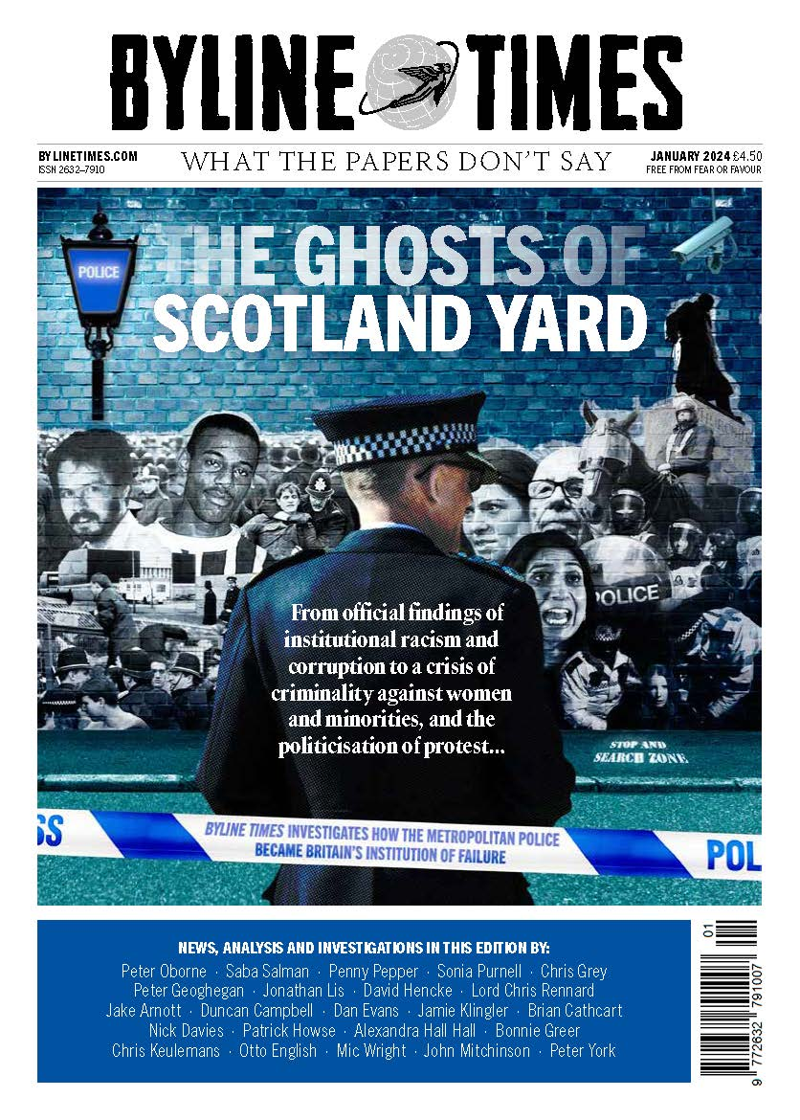
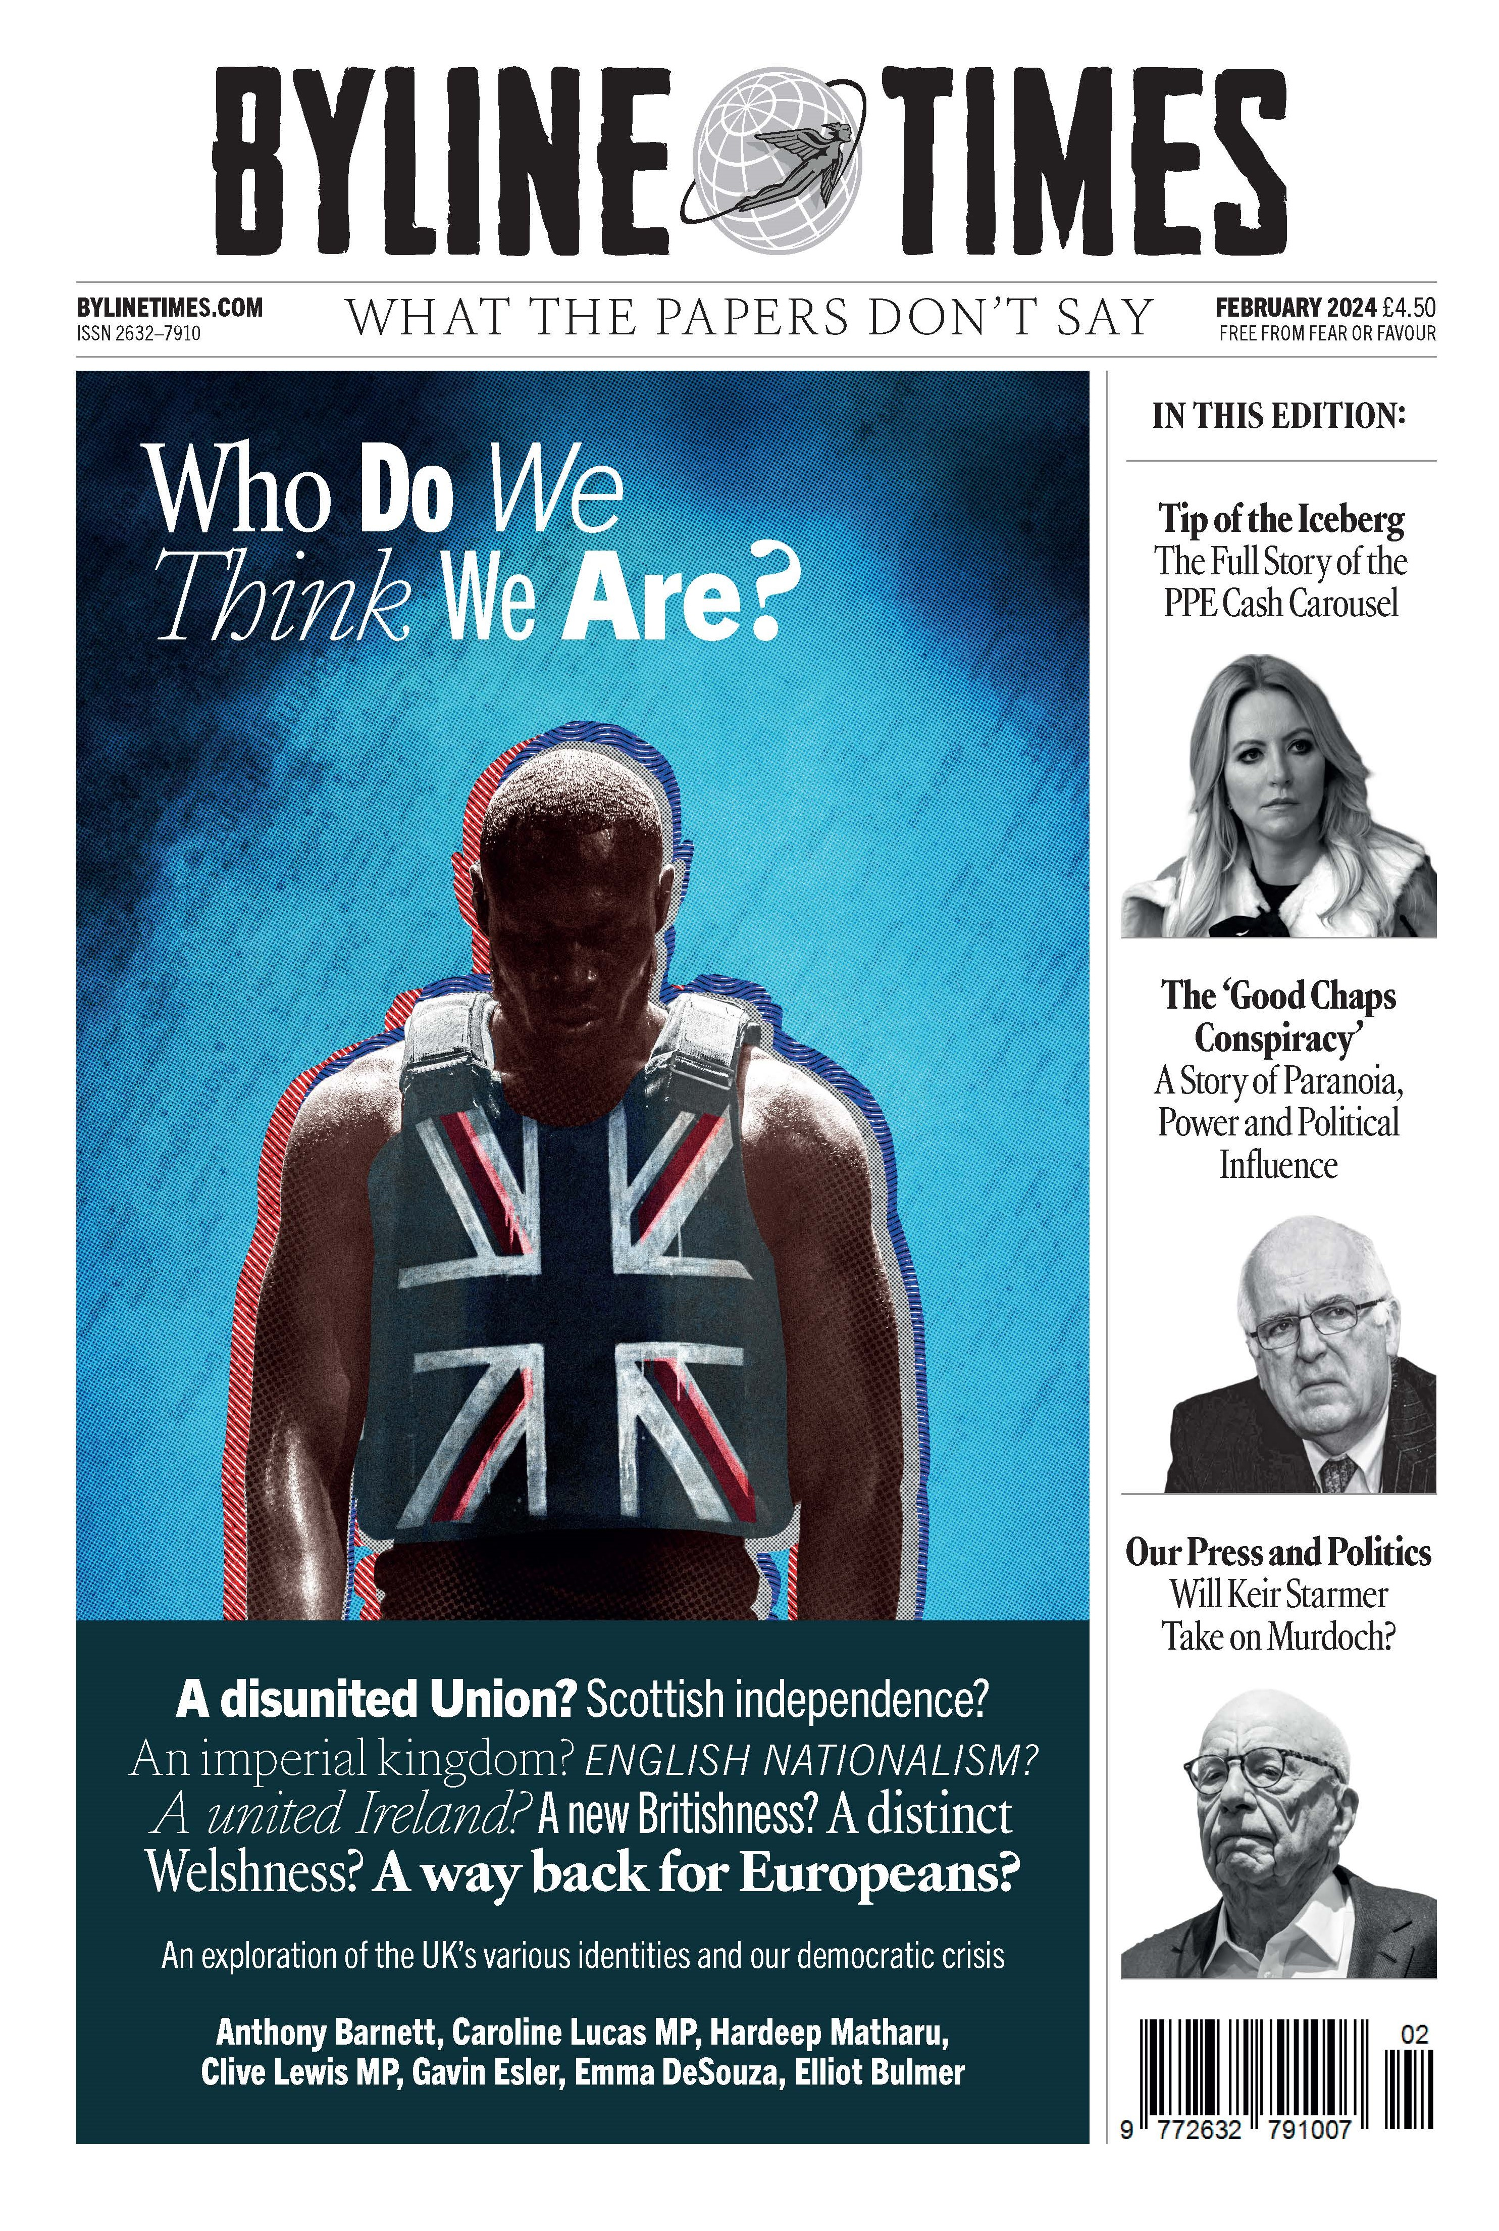
Byline Times Media Pack

Slide 2
Introduction and background to Byline Times
– What The Other Papers Don’t Say
Byline Times was launched in March 2019 and quickly built a strong subscriber base. It then launched in retail in October 2023
Its aim is to rediscover great journalism
Byline Times doesn’t follow the news cycle – instead, it probes and investigates where other papers aren’t looking and creates its own news cycle
Each monthly edition leads with a major investigation as well as other news, well-known columnists and culture
Byline Times follows the story wherever it goes and has a broad base of readers and subscribers from across the political spectrum
Its journalists and writers include: Carol Vorderman, Bonnie Greer, Peter Oborne, Peter York, Yasmin Alibhai-Brown, Adam Bienkov, Hardeep Matharu, Sonia Purnell, Peter Jukes, Anthony Barnett and Josiah Mortimer
Byline Times is part of the Byline Family that includes its annual Byline Festival, Byline Books, Bylines Networks and Byline TV

Slide 3

Byline Times Investigations
Byline Times has built a reputation for breaking major investigations many months before the rest of the press that have impact including:
Personal Protective Equipment (PPE) Scandal – this was revealed by Byline Times in April 2020 – 6 months before the rest of the press
Government’s intention to sell GP Data – our investigation prompted over 1 million people to opt out and persuaded the Government to reverse the policy
Russian Disinformation – since its launch we have been revealing the extent of this which was ignored by the other papers
Dan Wootton scandal – our investigation led to Dan Wootton being dropped by the Daily Mail and a police investigation

Slide 4
What our readers say…
“Byline Times. I am so impressed with these people! The integrity and dedication they’ve shown has made me trust them. With so much misinformation in the world, you can count on them for truth.” Emily @Emily263366886
“Very impressed by the very brave and important journalism undertaken by the Byline Times team.” Mathew Hulbert
“Gotta say Byline Times are emerging as a great outlet. Well researched and brilliantly coordinated. The Wooton stories are really bringing the limelight.” James @HeyGoAudio
“We really need to see Byline Times widely distributed, so the general public can choose to pick up in their local shops and news-stands.” Rayees @rayeesmusic
“This country needs the Byline Times more than ever. Thank you for all your hard work.” Sarah Lim
“Make sure to follow Byline Times for investigative reporting on all sorts of matters.” Carol Vorderman
“Thank you for everything that you and Byline and doing! On the edge of my seat waiting for the next instalment of this investigation.” @Wasaga18

Slide 5



GREAT WRITERS
Peter Oborne Former Chief Political Commentator, Telegraph
Sonia Purnell Award-winning author & journalist
Otto English Author & journalist
Carol Vorderman
TV Presenter and Radio Host
Alexandra Hall Hall Former Diplomat
Gavin Esler TV Presenter and author
Nafeez Ahmed Former Senior Reporter at VICE
Bonnie Greer Playwright, novelist & broadcaster

Slide 6

Figures - print, digital, newsletter, social.
Monthly Print Circulation = total 41,000 Oct 25’
Subscriptions = 32,000
Newsstand = 9,000
(*source woo commerce)
Bylinetimes.com daily news site = 600,000 Uniques
Weekly newsletter = 60,000
Social Media Followers
X (formerly twitter) = 202,000
Facebook = 29,000
Instagram = 40,000
TikTok = 26,000
BlueSky = 140,000

Slide 7

Readership Demographics
Top 3 readership communities:
Education 27%
Science and Engineering 18%
Creative Arts 12%
Age % of Subscribers
18-29 14%
30-39 18%
40-49 23%
50-59 26%
60 Plus 20%
Higher than average salary
Very highly educated – 89% have higher or further education
Source Subscriber Survey 2022

Slide 8
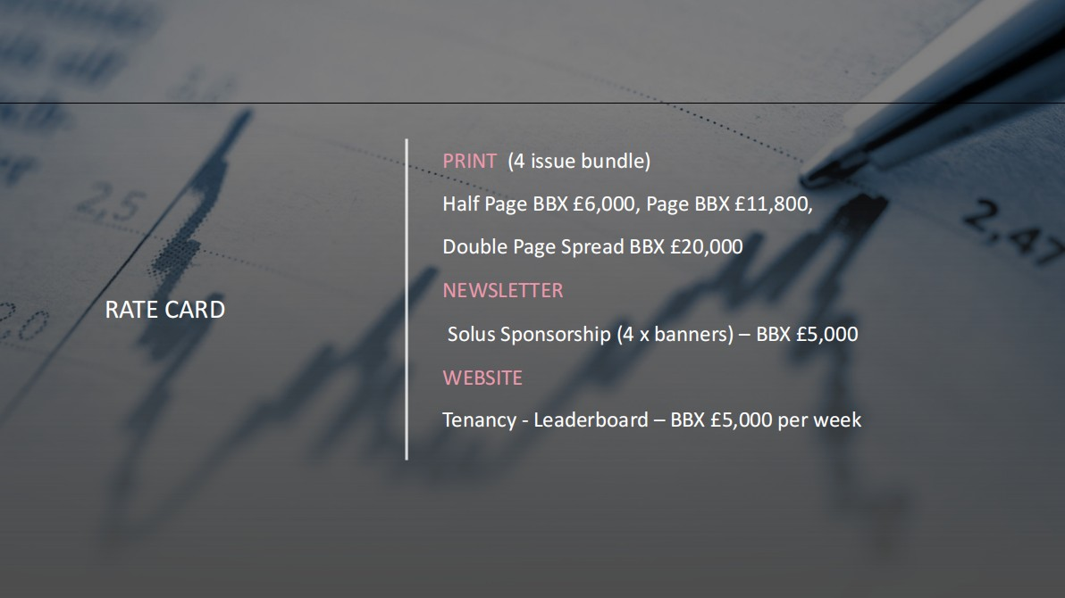
Rate card
PRINT
Half Page £1,500, Page £2,950, DPS £5,000
NEWSLETTER
Solus Sponsorship (1 x banners) - £2,500
WEBSITE
Tenancy - Leaderboard - £5,000 per week

Slide 9


Contact
mike@360publishing.co.uk
Tel 07917588511
ian@360publishing.co.uk
Tel 07814970732

Slide 10

Appendix – specs
Delivery dates
Edition Copy Deadline On Sale Deadline
December 06/11/25 20/11/25
January 04/12/25 18/12/25
February 08/01/26 22/01/26
March 03/02/26 17/02/26
Full page ad = A4: 297x210 mm
Half page ad = A5: 148X210 mm

